Slide 1
Homework
Exercise 3.1

Slide 2
Problem statement:

Slide 3
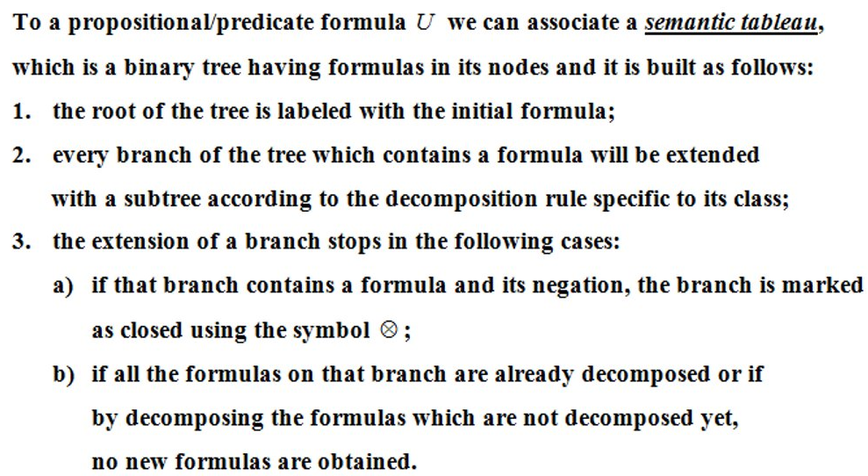
Theory

Slide 4
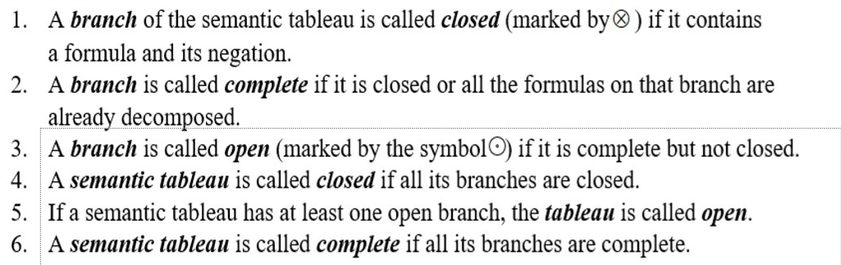
Theory

Slide 5
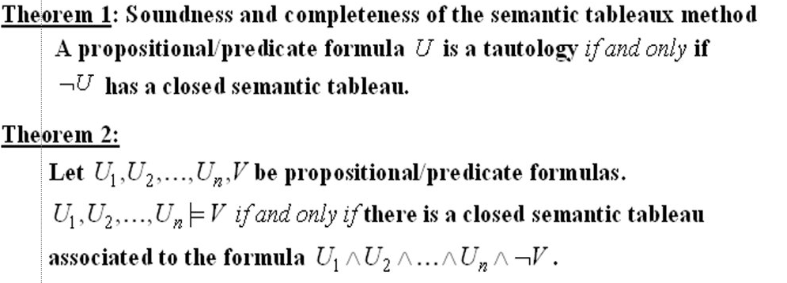
Theory

Slide 6
Building the semantic tableaux
U=(p →(¬ q∨r∧s)) ∧p∧ ¬ s∧q (1)
| -α rule for (1)
p →(¬ q∨r∧s) (2)
|
p
|
¬s
|
q
/ \ -β rule for (2)
¬p (¬ q∨r∧s) (3)
/ \ -β rule for (3)
¬ q r ∧ s(4)
|-α rule for (4)
r
|
s

Slide 7
Conclusion
Since there are no open branches, the semantic tableaux is closed and the logical consequence holds.

